Slide 1
Wine Reviews
Group 5
Yafei Lou
Qingqing Hu

Slide 2


Project Inspiration
How to train the model to identify the wine quality based on its description that an expert could give?

Slide 3
About Dataset
The dataset consists of 1599 rows and 12 Input variables and one output variable.
Input variables include fixed acidity, volatile acidity, citric acid, residual sugar, chlorides, free sulfur dioxide, total sulfur dioxide, density, pH, sulphates, alcohol.
Output variable is the wine quality (score between 0 and 10)
Specially, for the classification model, we divide the wine into two classes, Good (7~8) with 217 rows and Medium (3~6) with 1382 rows.

Slide 4
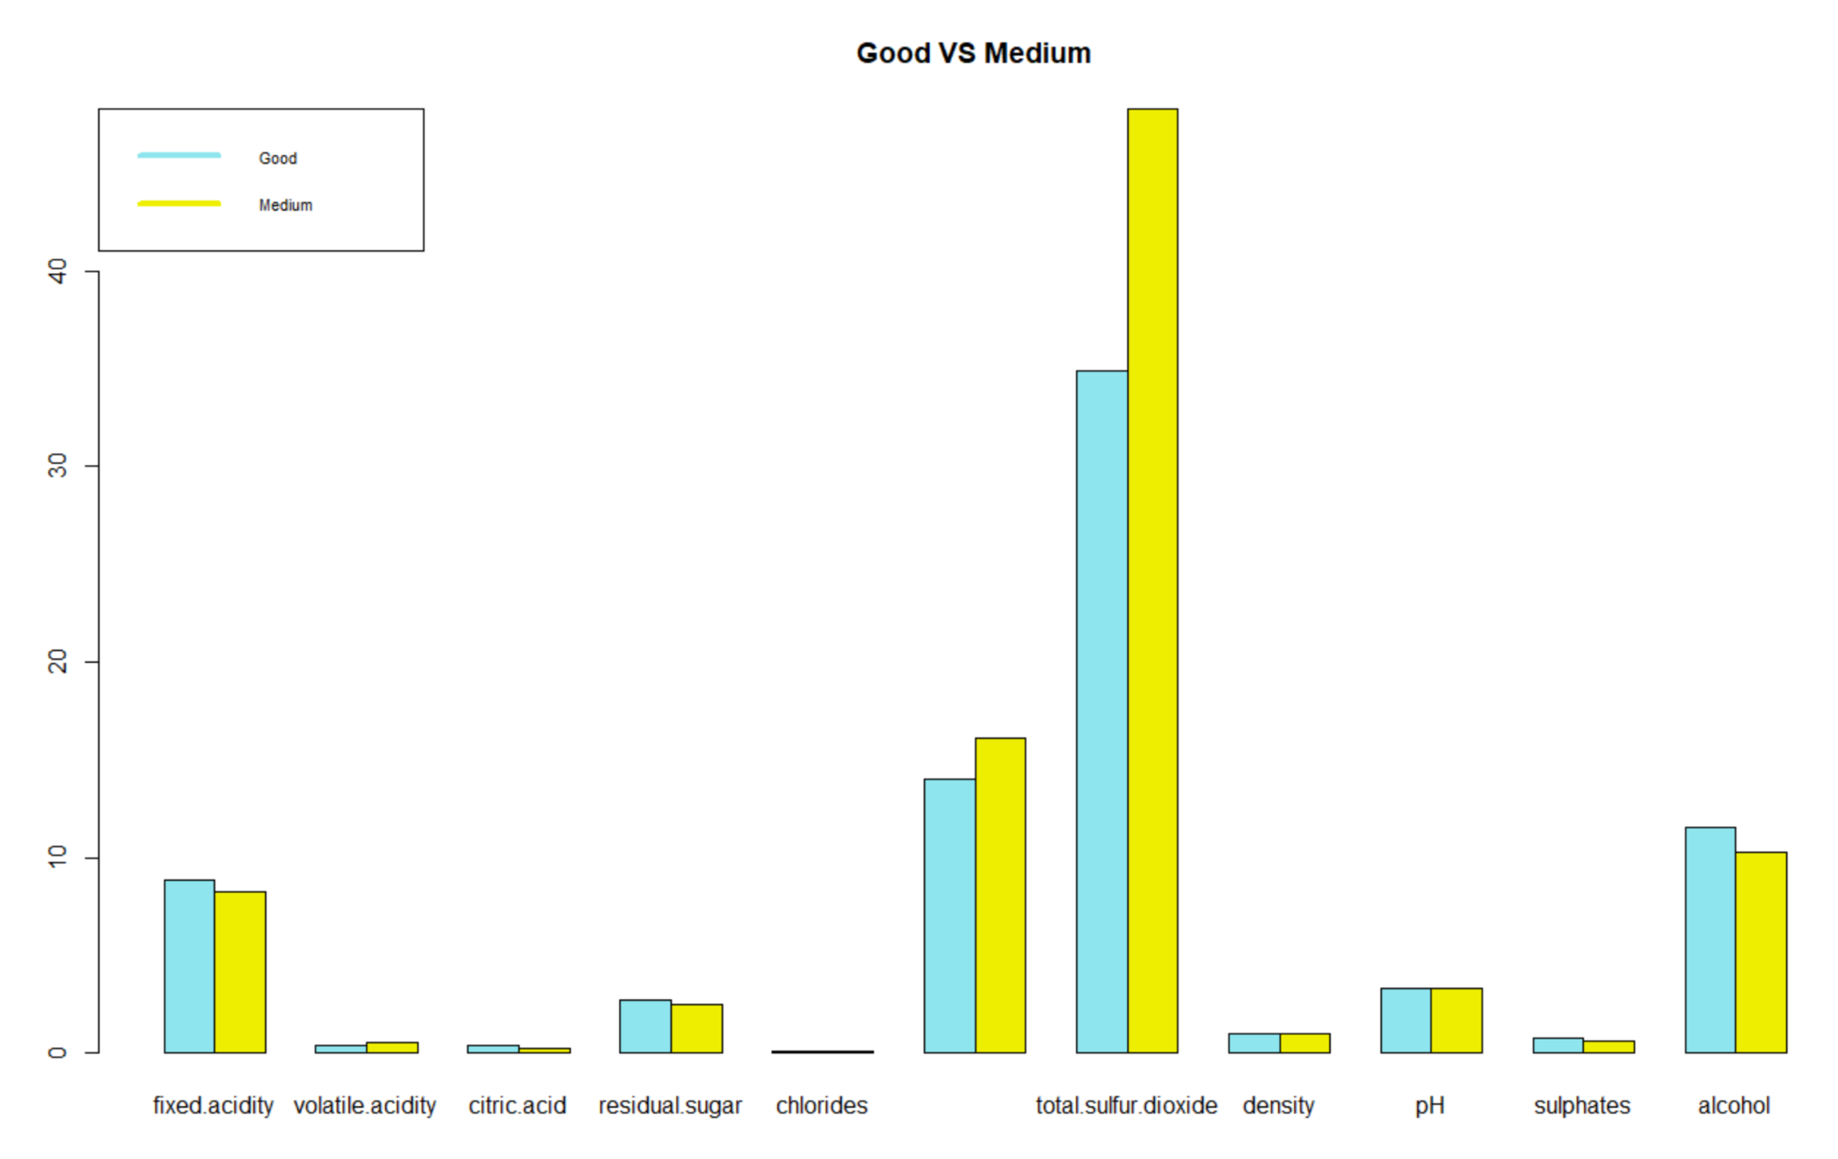
Average Distribution of 11 ingredients in two classes
Set average level for each ingredient
Difference:
total sulfur dioxide,
free sulfur dioxide
alcohol
fixed acidity

Slide 5
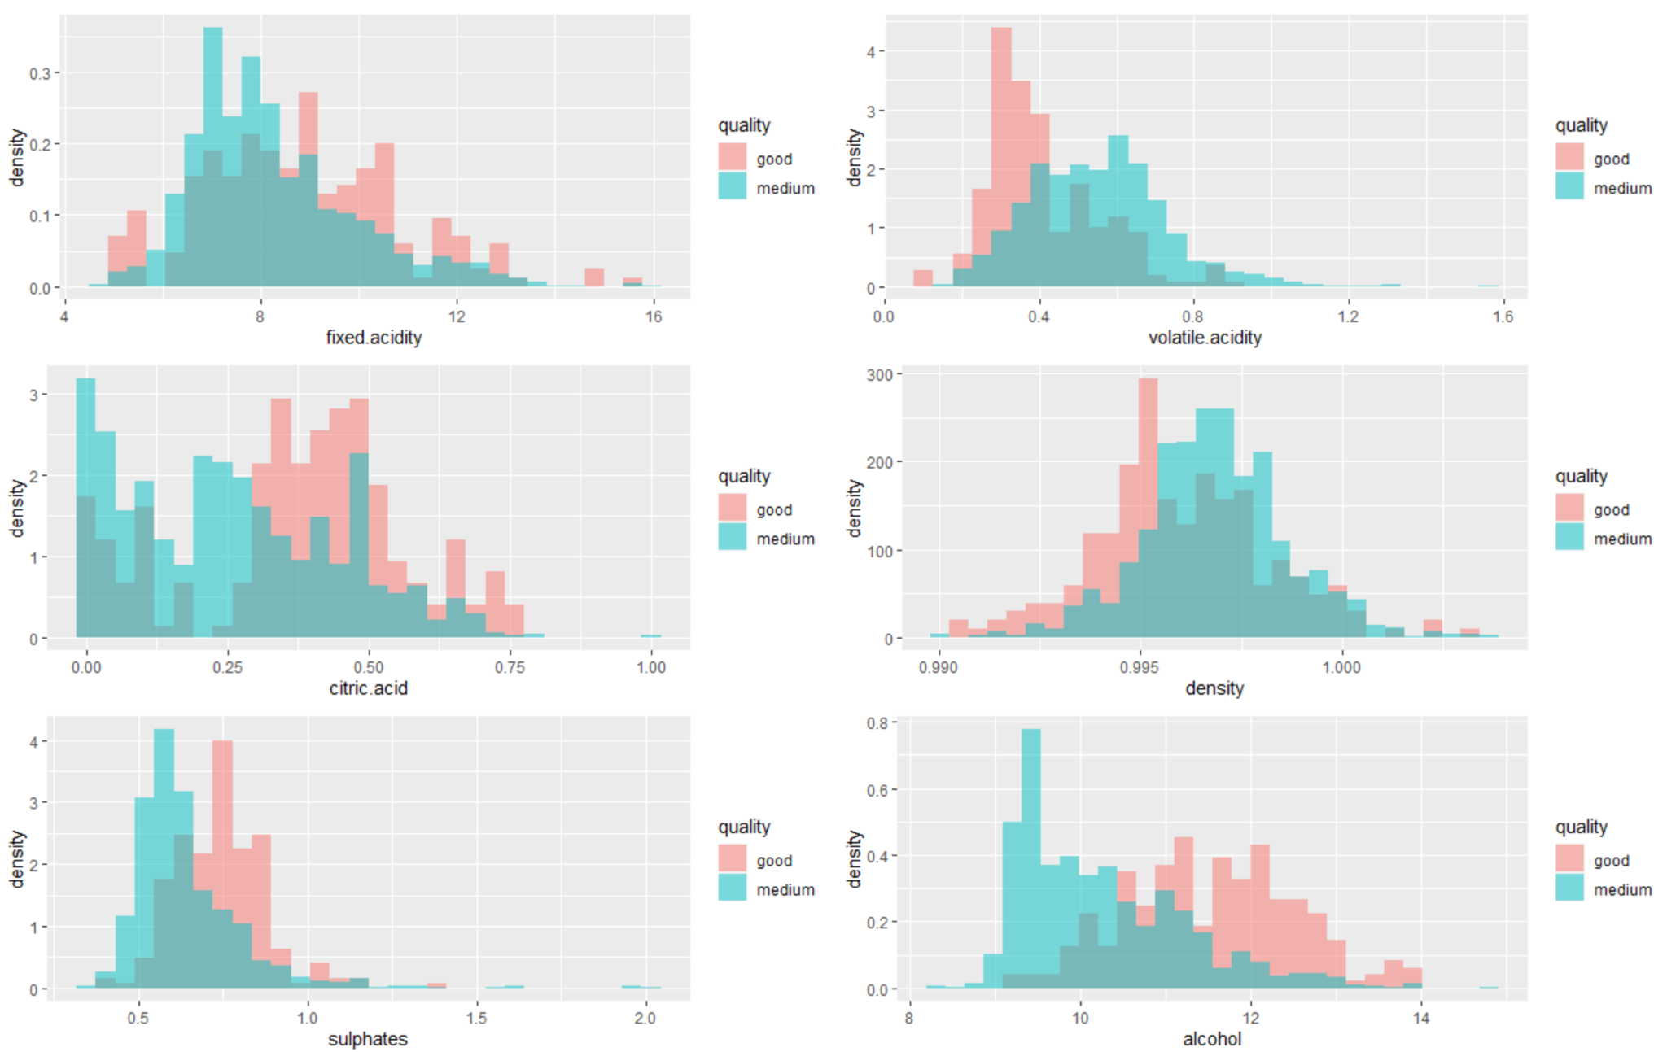
Distribution of Six ingredients in two classes
Focus on the amount range of six ingredients separately and distributions.
The smaller the shadow is, the greater difference they have.

